Slide 1

Exploratory Data Analysis
<G2M Insight For Cab Investment Firm>
<Yena Lee>

Slide 2

Agenda
Executive Summary
Problem Statement
Approach
EDA
EDA Summary
Recommendations

Slide 3
Summary
XYZ, a private equity firm in the US, is looking to invest in the Cab Industry due to its remarkable growth in recent years and the presence of several key players in the market. As an intern assigned to the project, my responsibility is to conduct a comprehensive quantitative analysis of existing datasets and provide market trends on Yellow and Pink cab companies to assist XYZ in making informed investment decisions.

Slide 4
Data
There are 4 datasets given in the format as .csv
Cab_Data.csv – this file includes details of transaction for 2 cab companies
Customer_ID.csv – this is a mapping table that contains a unique identifier which links the customer’s demographic details
Transaction_ID.csv – this is a mapping table that contains transaction to customer mapping and payment mode
City.csv – this file contains list of US cities, their population and number of cab users
Merged these 4 datasets into a master dataset

Slide 5
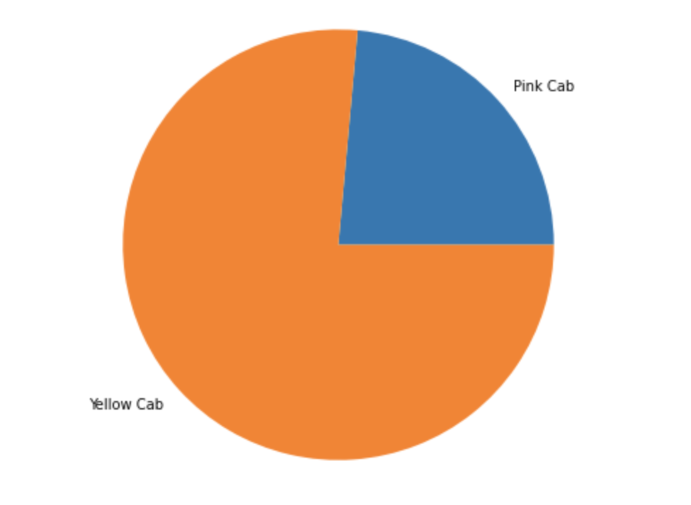
Analysis
Yellow Cab has more transaction numbers than Pink Cab

Slide 6
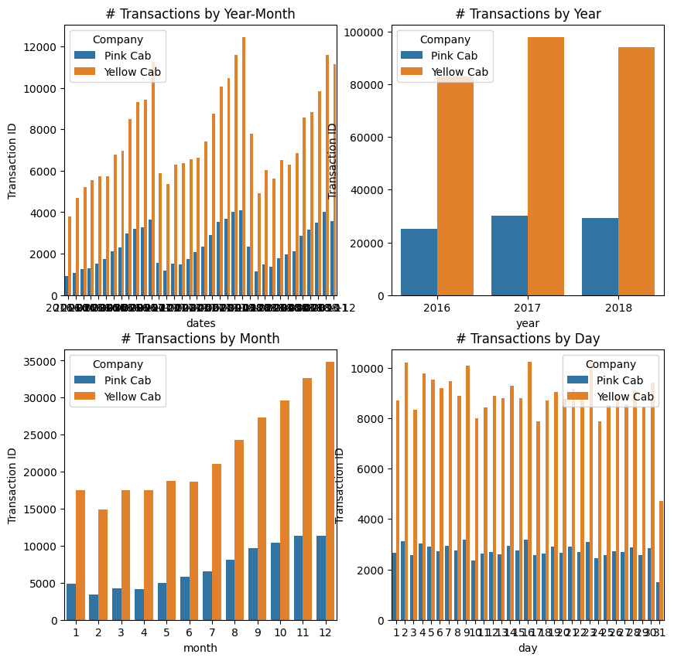
Number of Transaction

Slide 7
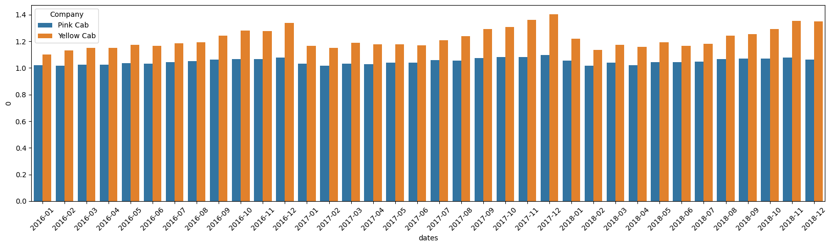
Unqique # of Customer

Slide 8
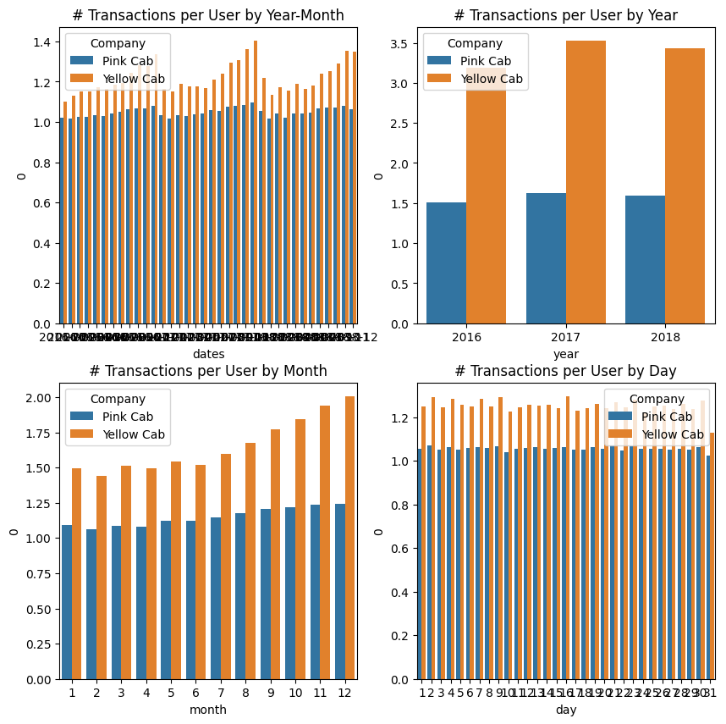
Avg Transaction Per User

Slide 9
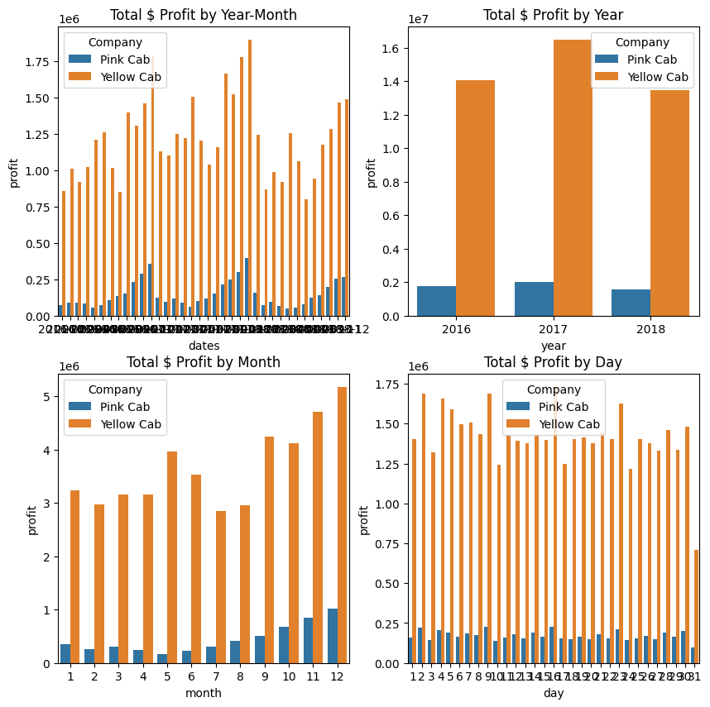
Total Profit

Slide 10
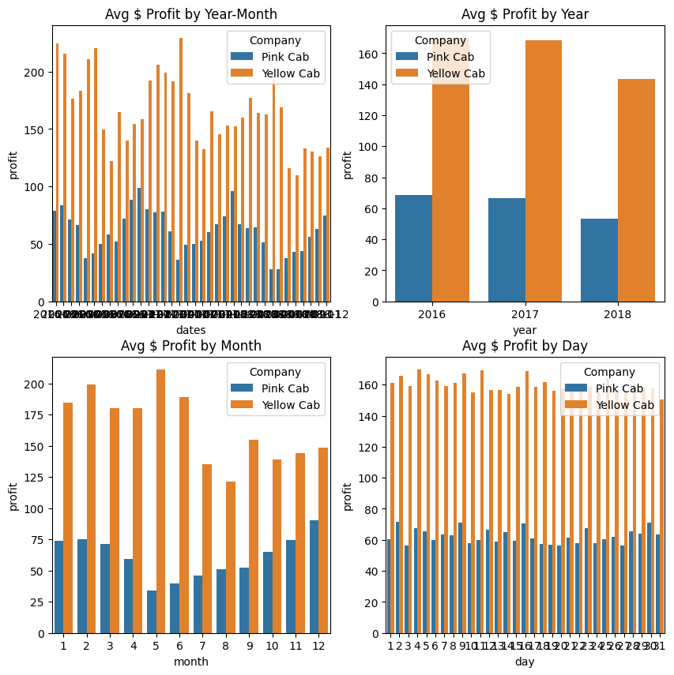
Avg Profit Per Transaction

Slide 11
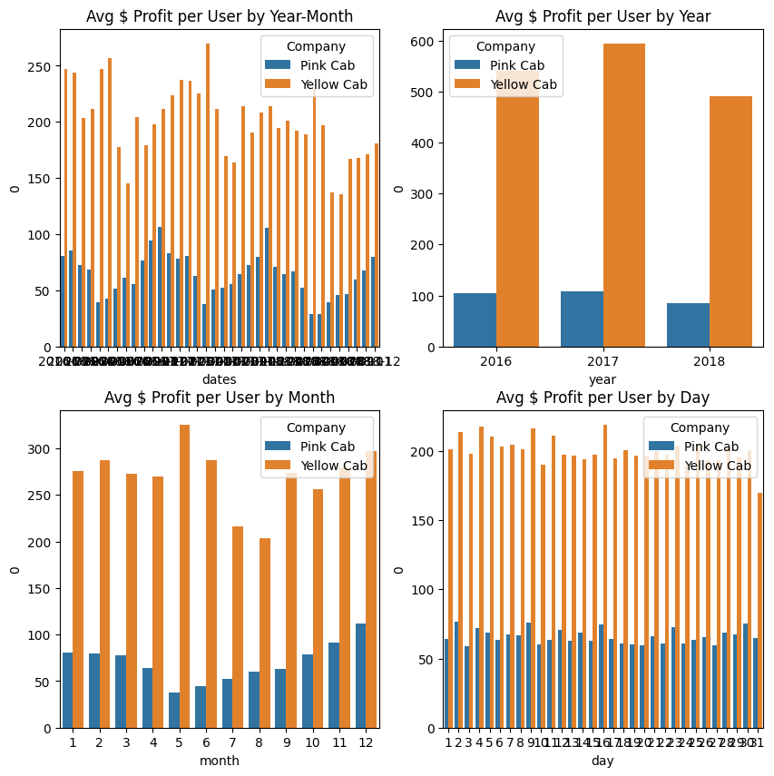
Avg Profit Per User

Slide 12
Avg Profit Per User

Slide 13
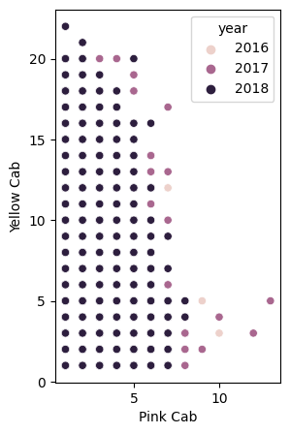
Royal Users

Slide 14
Recommendation
Based on the available data, it can be observed that Yellow Cab company appears to be a stronger player in the market compared to Pink Cab company. This is supported by two key factors:
Yellow Cab has a larger user base and a higher number of transactions compared to Pink Cab.
Yellow Cab generates greater profits, with a higher average profit margin than Pink Cab.
By considering these two points together, it is evident that Yellow Cab holds a stronger position in the cab industry compared to Pink Cab.

Slide 15
Thank You

